Slide 1
Home Credit Default Risk
-Unsupervised Learning
Long Fang, Xia Fu, Feiman Li

Slide 2

Background
Banks have been relying on scoring models to access credit risk. Today, with machine learning algorithms, the forecasts of future repayments are much more reliable. in this project, we classified customers through unsupervised learning algorithms and analyzed the weight of variables in identifying whether customers will default. The data are provided by Home Credit, a service dedicated to the unbanked population with lines of credit (loans).

Slide 3
Data Description
This dataset contains all the information about each loan application at Home Credit. Every loan has its own row and is identified by the feature SK_ID_CURR. The training application data comes with the TARGET indicating 0 (the loan was repaid) or 1(the loan was not repaid). This dataset contains information including the following aspects: personal information (age, gender, family, etc.), housing information, credit score from external sources, as well as borrowers' employment information, etc. There are 122 variables and 307,511 observations in the dataset. Among the 122 variables including target, 67 of which are float variables, 43 are integer variables and 13 are string variables. As for quality, 67 variables have missing values.

Slide 4
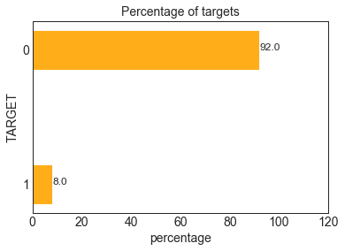
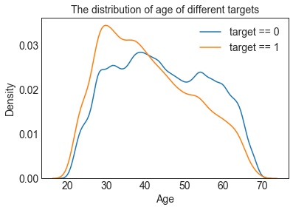
Exploratory Data Analysis
From this information, we see this is an imbalanced class problem. There are far more loans that were repaid on time than loans that were not repaid. Once we get into more sophisticated machine learning models, we can weight the classes by their representation in the data to reflect this imbalance.
We wanted to know whether the age of borrowers’ contribute to their final result. From the plot below, I found that young people more tend default than older people, which makes sense. Thus, age is an important factor that I should include in our model.

Slide 5
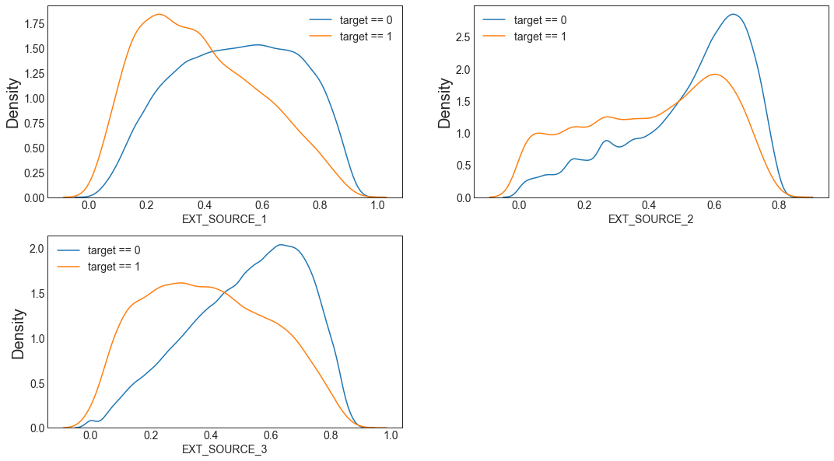
Exploratory Data Analysis
EXT_SOURCE is normalized external credit score. In total, applicants who got lower credit score are more likely to default. However, EXT_SOURCE_2 might not be a good indicator of default.

Slide 6
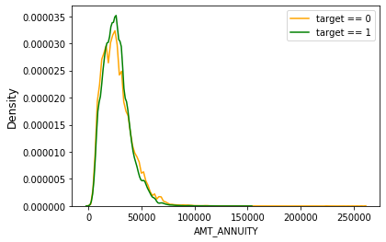
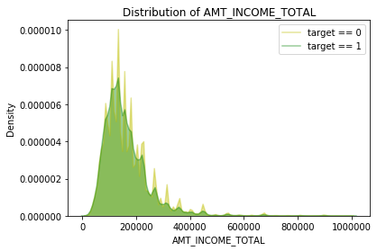
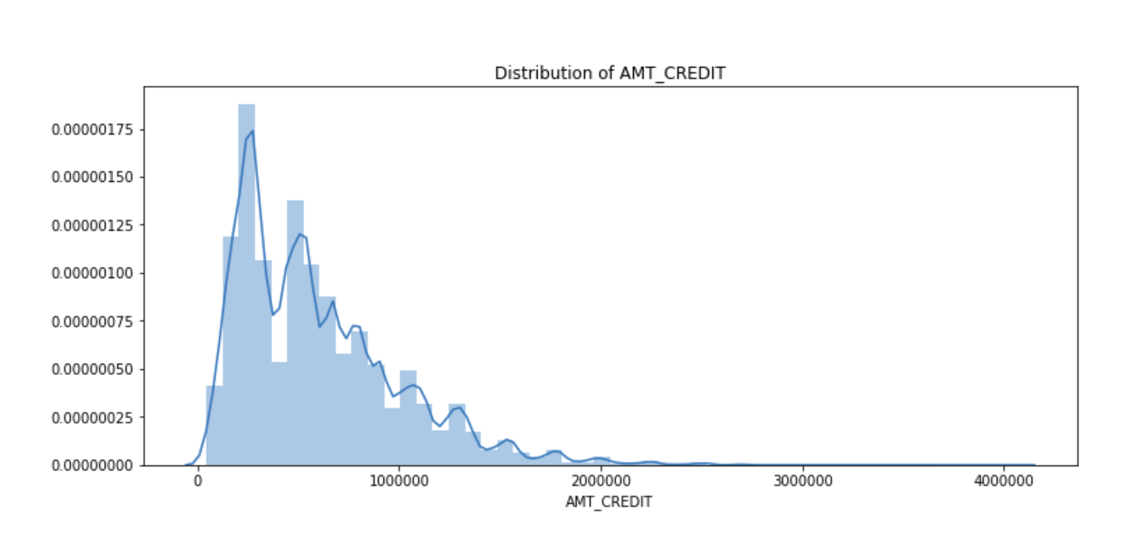
Exploratory Data Analysis
The loan annuity is right skewness that Income, which make sense since people tend to pay for loan that is smaller than income.

Slide 7
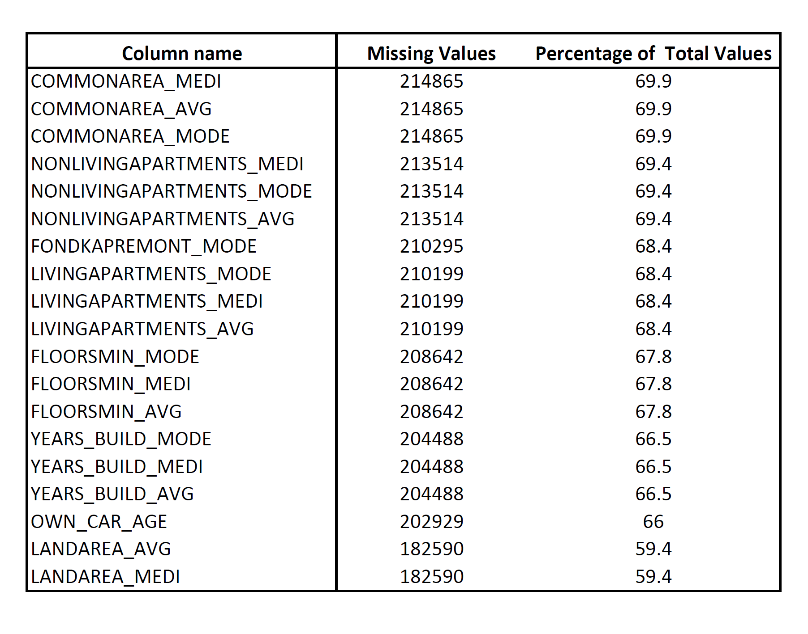
Feature Engineering
As you can see, there are lots of similar variables in the missing value table. For example, the first three features, COMMONAREA_MEDI, COMMONAREA_AVG, COMMONAREA_MODE, all provide normalized information about spaces where the client lives, such that average (_AVG suffix), modus (_MODE suffix) and median (_MEDI suffix) common area. We choose to keep one of the three variables and set missing value as -1, resulting in 29 variables being deleted in total.
There are 67 columns that have missing values.

Slide 8
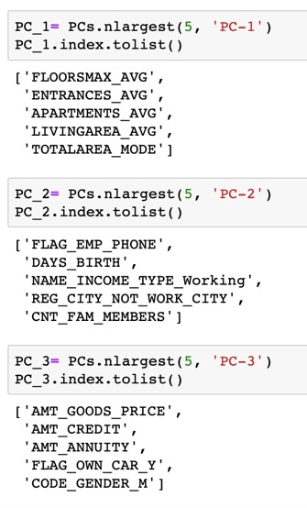
Feature Engineering
Because there are have too many variables after one hot coding, I choose to use PCA to reduce dimensions. I set to keep 99% of the variation, and I retained 3 components.

Slide 9
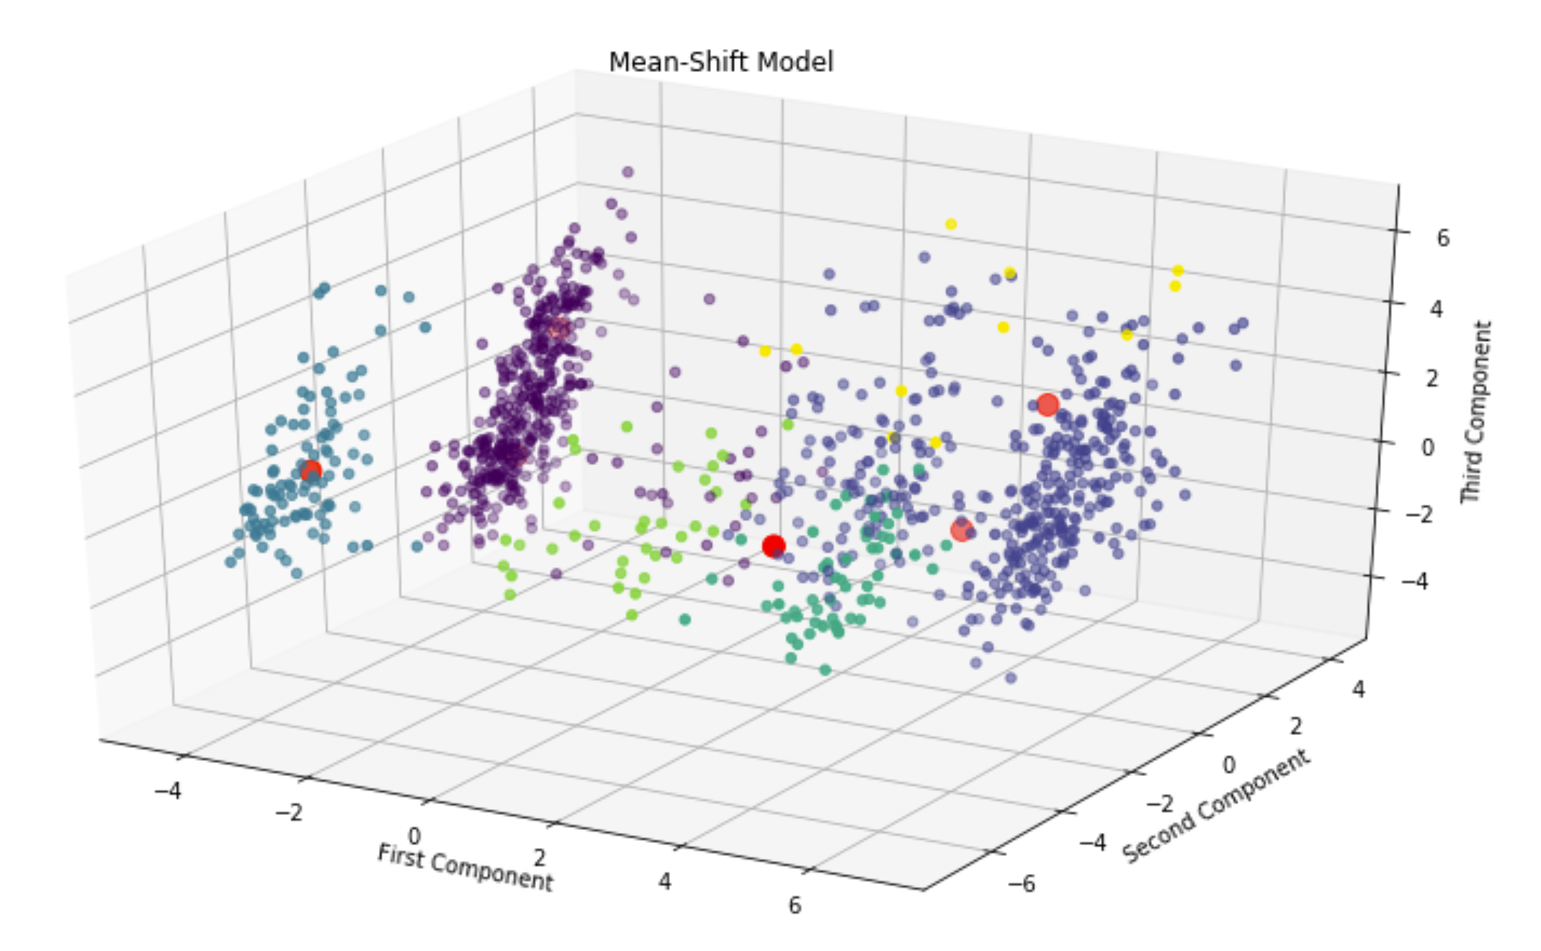
Modeling: Mean-Shift
In order to compare with K-means clustering, we conduct Mean-shift clustering. We calibrated our model with grid search for best bandwidth. We set quantile equals to 0.1 and n_sample equals to 1,000 and the best bandwidth is 2.53 also with 6 clusters.

Slide 10
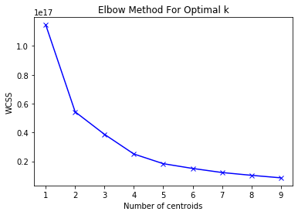
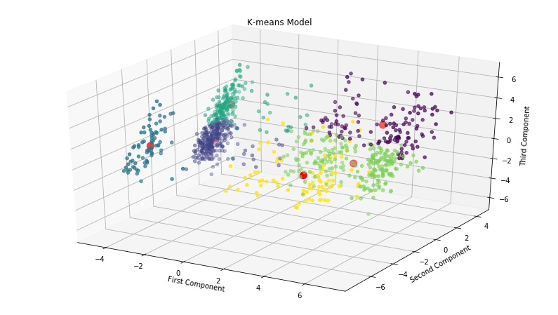
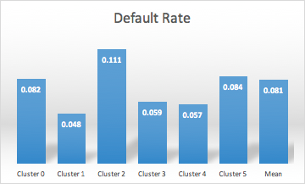
Modeling: K-Means
Find optimal K value
Fit K-Means Model
Analysis/ Interpretation

Slide 11
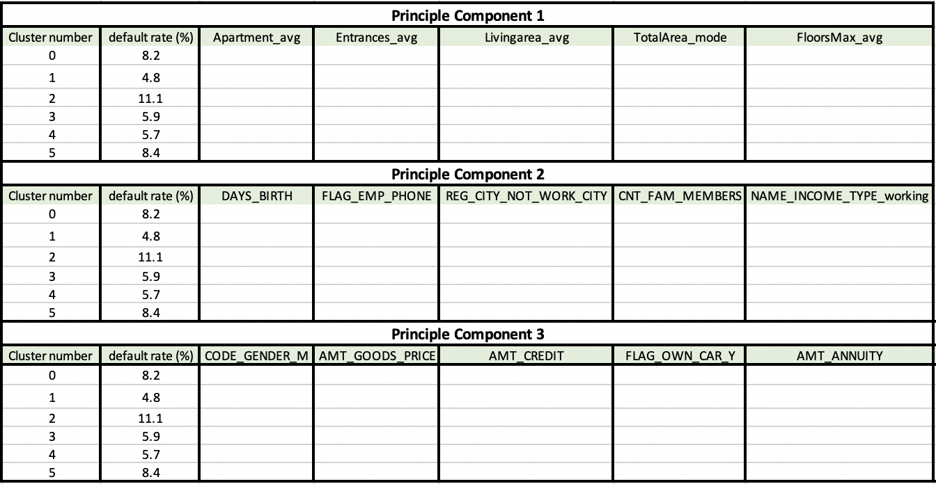
Interpretation

Slide 12
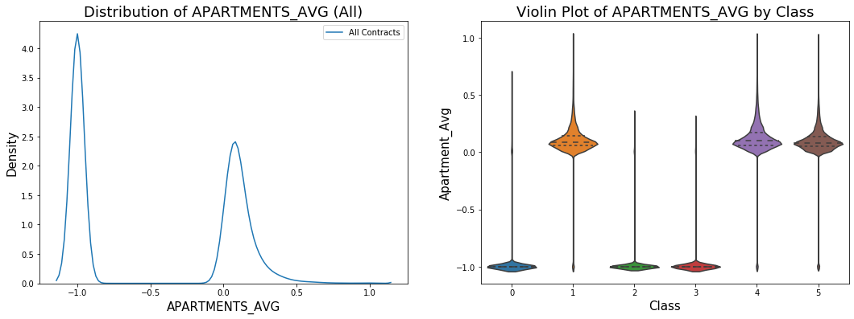
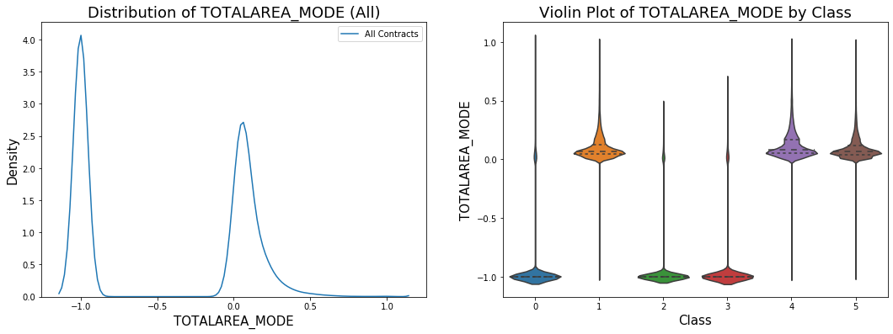
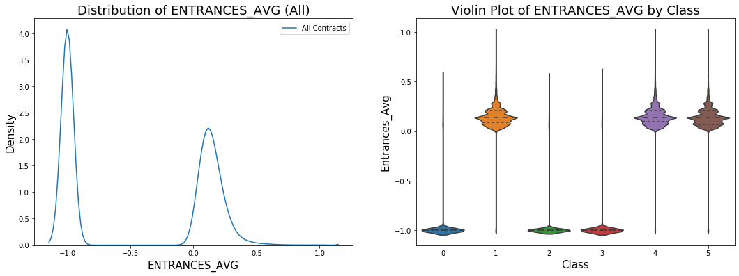
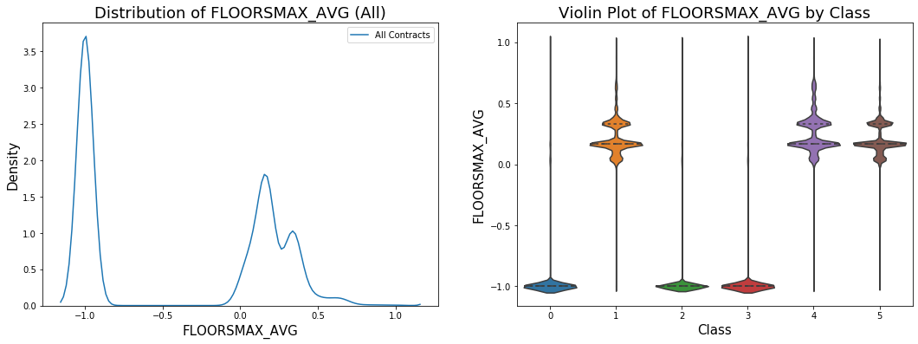
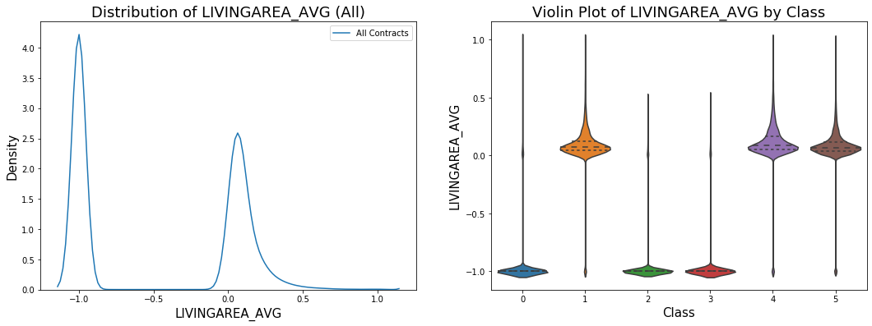
Interpretation - Principle Component 1
Clusters 1 & 4 & 5 have values of these property features.
The other clusters 0 & 2 & 3 are most likely to have missing values.

Slide 13
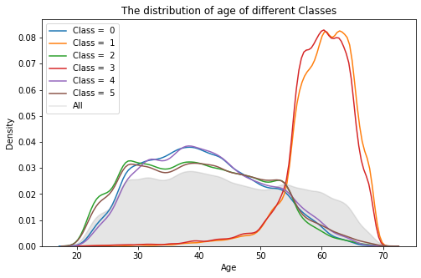
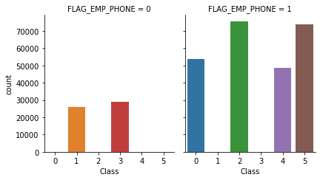
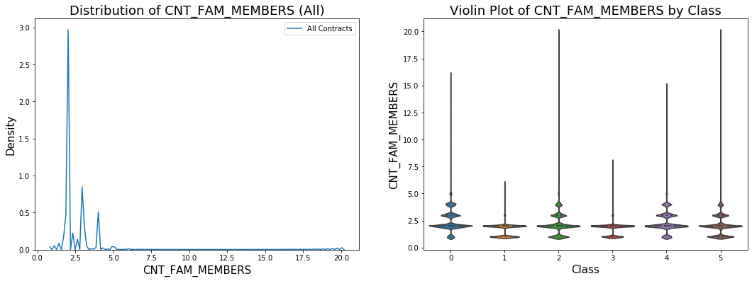
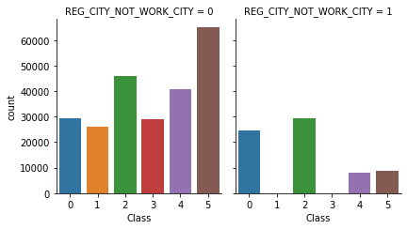
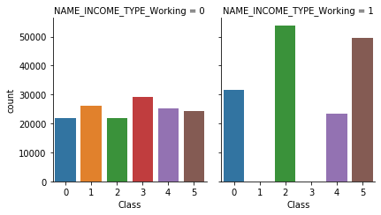
Interpretation - Principle Component 2
Because people in cluster 1 and 3 are older, so they are not employed and have no working information.
The range of family member number is more meaningful for cluster 1 and 3.

Slide 14
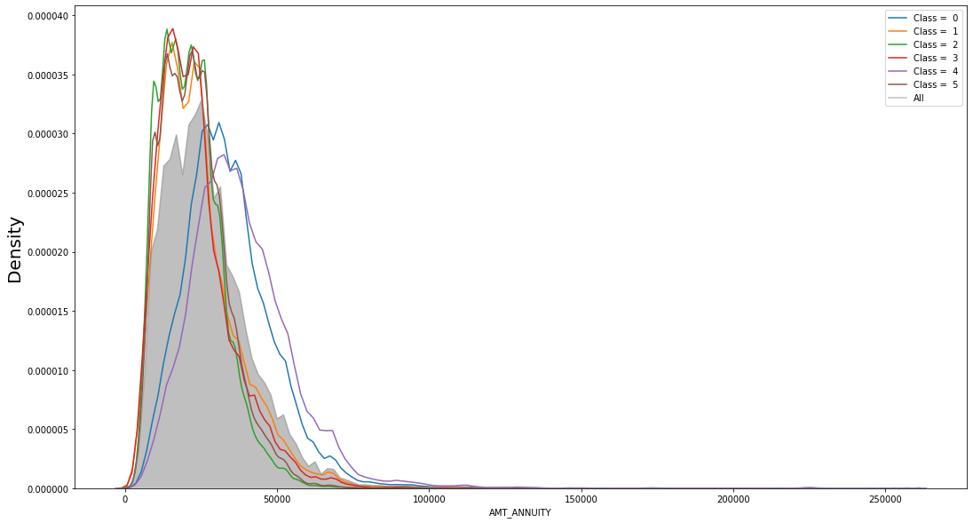
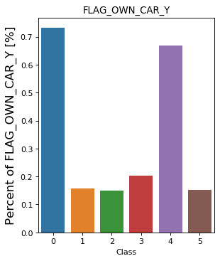
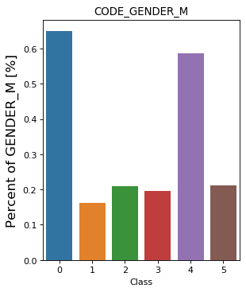
Interpretation - Principle Component 3
Cluster 0 and 4 have higher loan annuity.
Cluster 0 and 4 are more likely to own a car.
people in cluster 0 and 4 are most likely male.

Slide 15
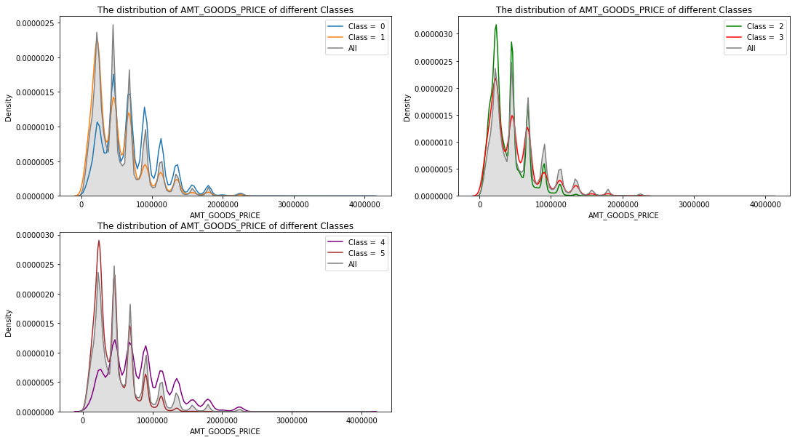
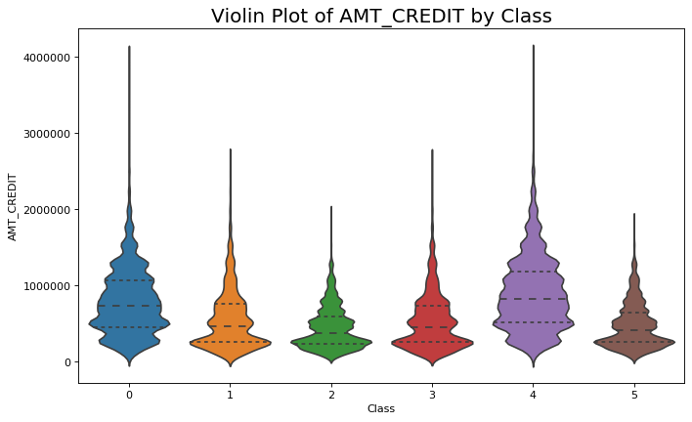
Interpretation - Principle Component 3
Cluster 0 and 4 tend to have higher prices of goods.
Cluster 0 and 4 tend to have higher credit.

Slide 16
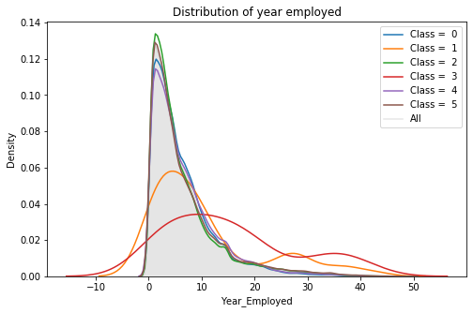
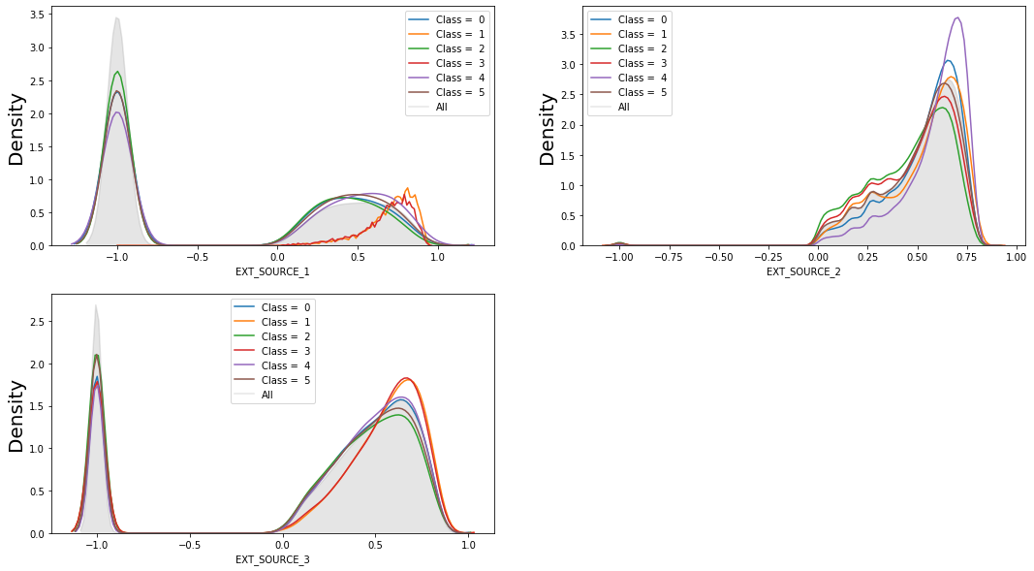
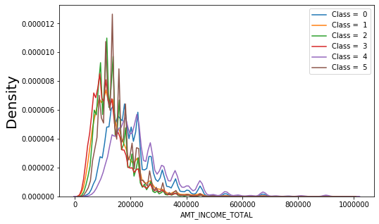
Other Features
Cluster 1 and 3 have more people who have worked more than 5 years.
People who are in Cluster 0 and 4 tend to earn more money
Cluster 1 & 3 perform better in EXT_SOURCE 1 & 3.
Cluster 4 perform slightly better in EXT_SOURCE 2.
Notice that Cluster 1 & 3 & 4 have lower average default rate.

Slide 17
Characteristics of Each Cluster
Cluster 0 (8.2% default rate): higher amount of income; higher percentage of owning a car; higher percentage of male; more likely to have missing value of housing information; higher average credit amount; higher amount of goods price; more likely to have the work phone; different working city to permanent address; abnormal amount of family members.
Cluster 1 (4.8% default rate): higher percentage of old people (aged 60 or higher); less likely to have information about work phones; longer years of employment; higher credit score at external source 1 & 3.
Cluster 2 (11.1% default rate): more likely to have missing value of housing information; different working city to permanent address; unnormal amount of family members; lower average credit amount.
Cluster 3 (5.9% default rate): higher percentage of old people (aged 60 or higher); more likely to have missing value of housing information; less likely to have information about work phones; higher credit at external source 1 & 3; longer year of employment.
Cluster 4 (5.7% default rate): high average income; high percentage of owning a car; high average credit amount; better credit at external source 2; higher percentage of male; higher amount of goods price.
Cluster 5 (8.4% default rate): normal average default rate; low percentage of owning a car; low average credit amount. Similar characteristics as cluster 2 except for that it has filled property information.

Slide 18
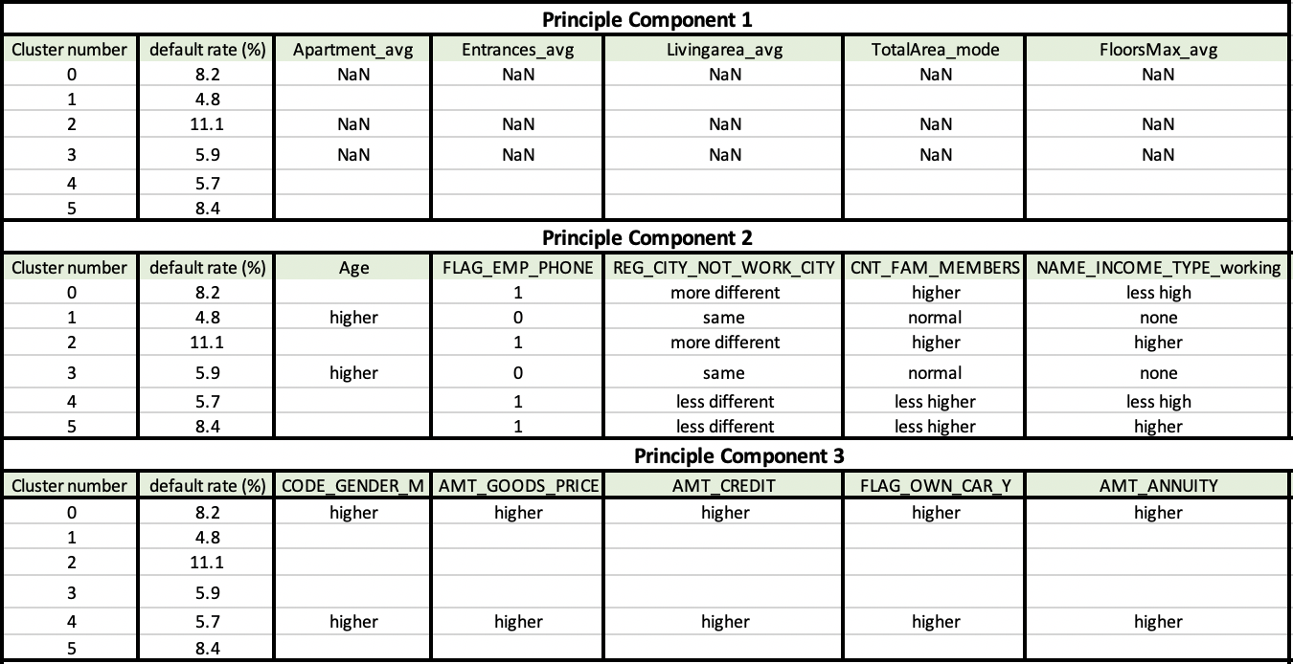
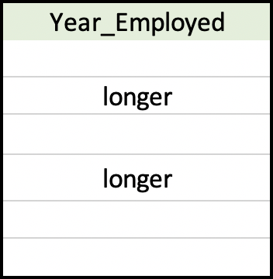
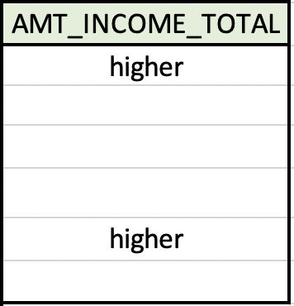
Characteristics Summary Table
We suggest that our client attach great importance to these variables. Financial Institutes can classify future borrowers according to these characteristics, and evaluate their default risk.

Slide 19
Thanks For Your Listening!

